Slide 1


Boston Airbnb Analysis
View in Power BI
Last data refresh:
6/23/2023 9:55:37 AM UTC
Downloaded at:
6/23/2023 11:17:00 AM UTC

Slide 2
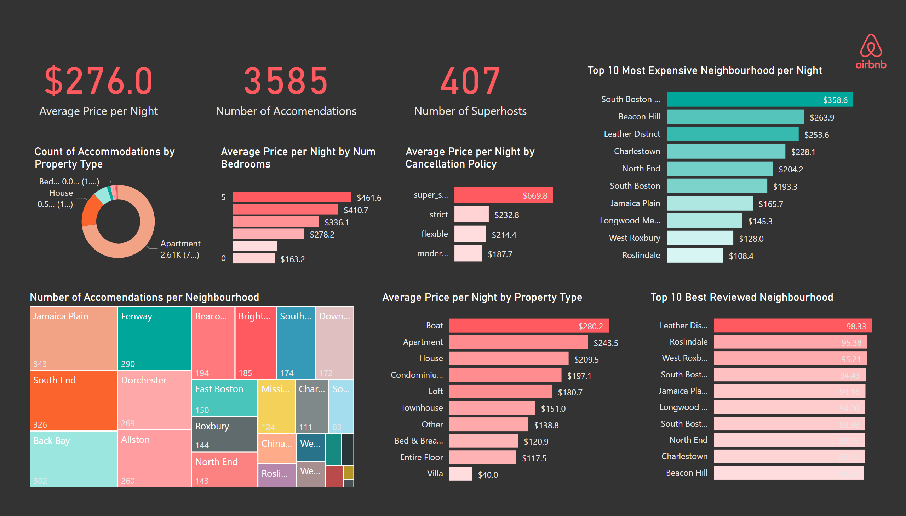
Accomendation Overview
Notes:
Number of Accomendations per Neighbourhood
No alt text provided
Top 10 Best Reviewed Neighbourhood
No alt text provided
Average Price per Night by Property Type
No alt text provided
card
No alt text provided
Top 10 Most Expensive Neighbourhood per Night
No alt text provided
card
No alt text provided
Count of Accommodations by Property Type
No alt text provided
card
No alt text provided
Average Price per Night by Num Bedrooms
No alt text provided
Average Price per Night by Cancellation Policy
No alt text provided
image
No alt text provided

Slide 3
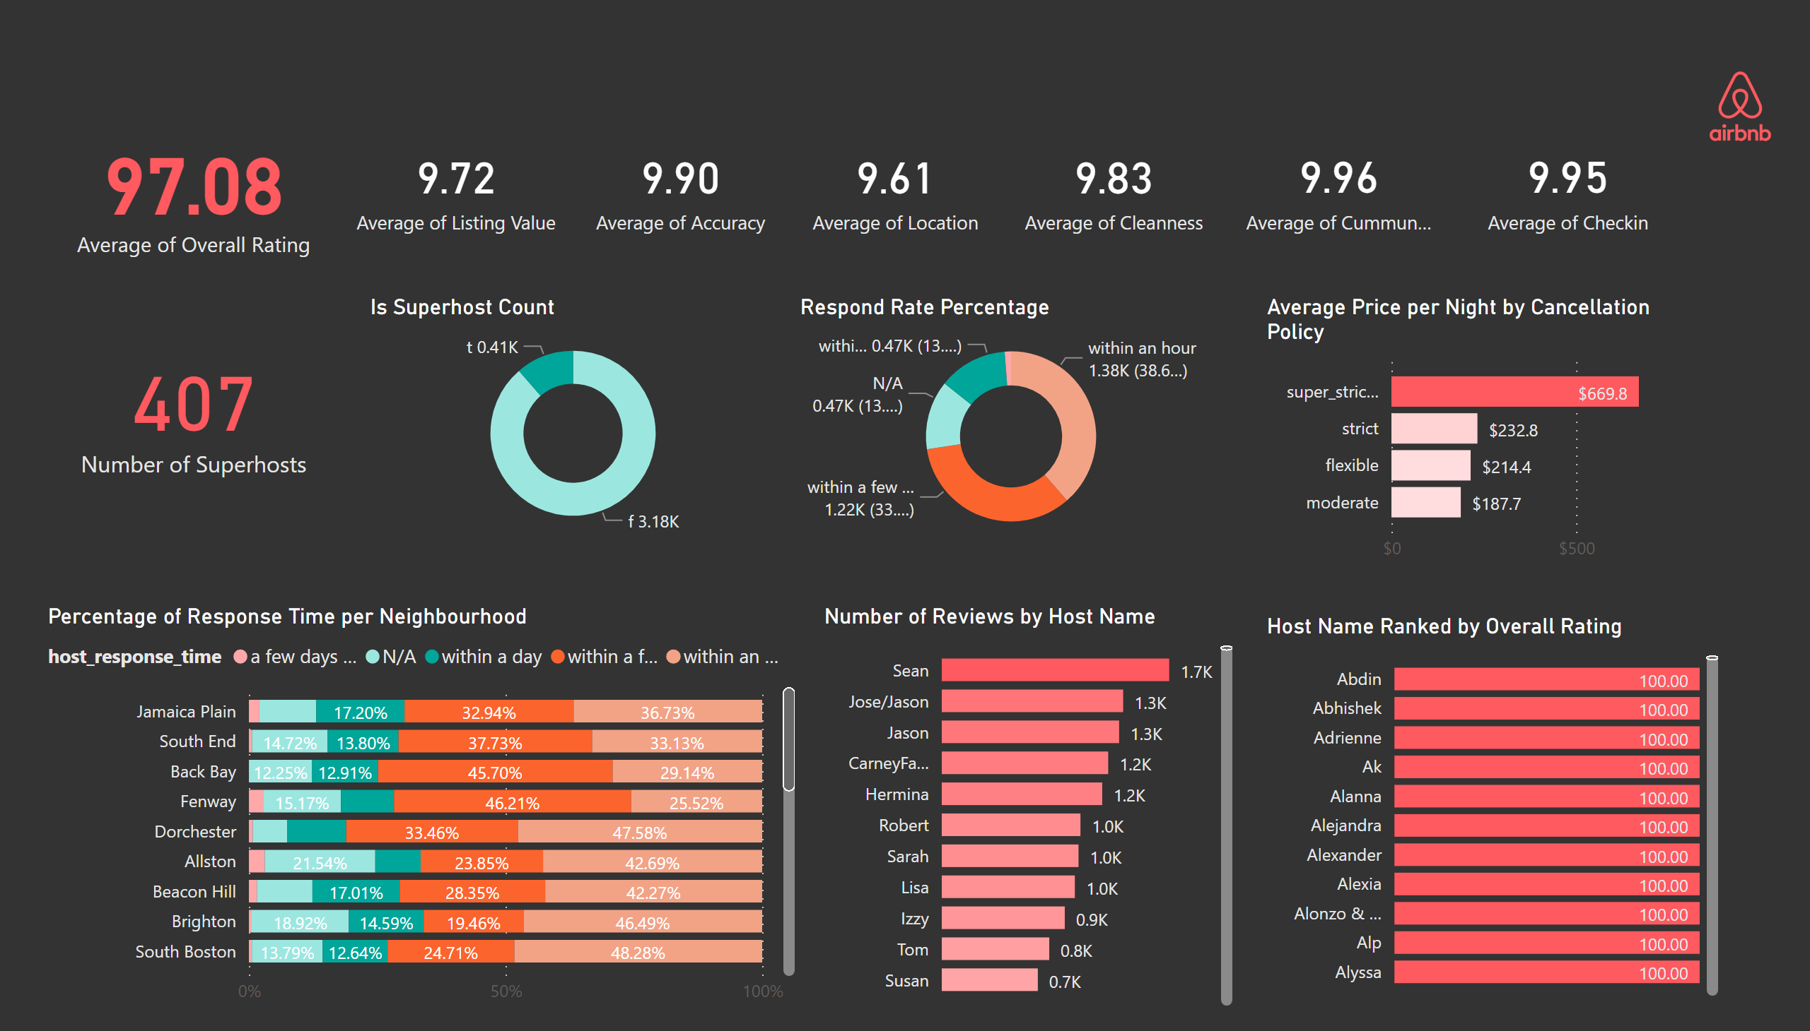
Host Analysis
Notes:
card
No alt text provided
Percentage of Response Time per Neighbourhood
No alt text provided
Respond Rate Percentage
No alt text provided
Number of Reviews by Host Name
No alt text provided
Host Name Ranked by Overall Rating
No alt text provided
card
No alt text provided
card
No alt text provided
card
No alt text provided
card
No alt text provided
card
No alt text provided
card
No alt text provided
card
No alt text provided
Is Superhost Count
No alt text provided
Average Price per Night by Cancellation Policy
No alt text provided
image
No alt text provided

Slide 4
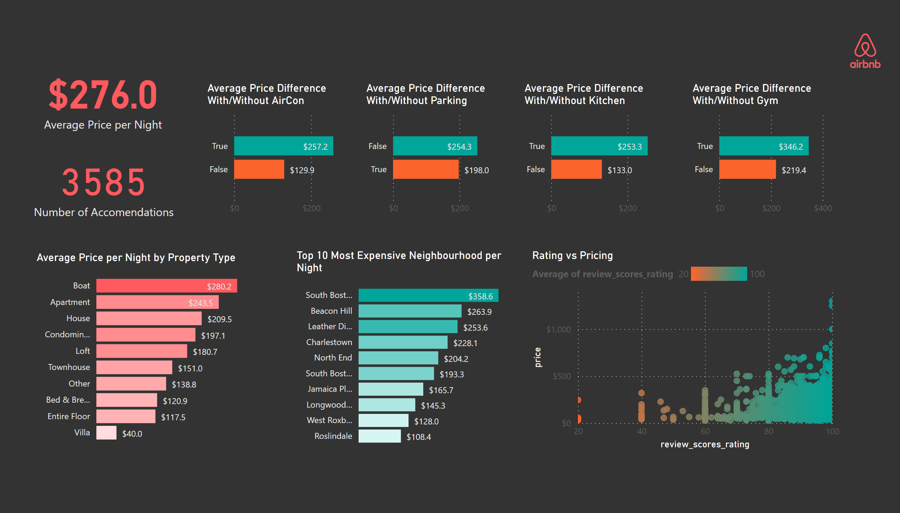
Price Analysis
Notes:
Average Price Difference With/Without AirCon
No alt text provided
image
No alt text provided
Average Price Difference With/Without Parking
No alt text provided
Average Price Difference With/Without Gym
No alt text provided
Average Price Difference With/Without Kitchen
No alt text provided
card
No alt text provided
card
No alt text provided
Top 10 Most Expensive Neighbourhood per Night
No alt text provided
Average Price per Night by Property Type
No alt text provided
Rating vs Pricing
No alt text provided

